Slide 1

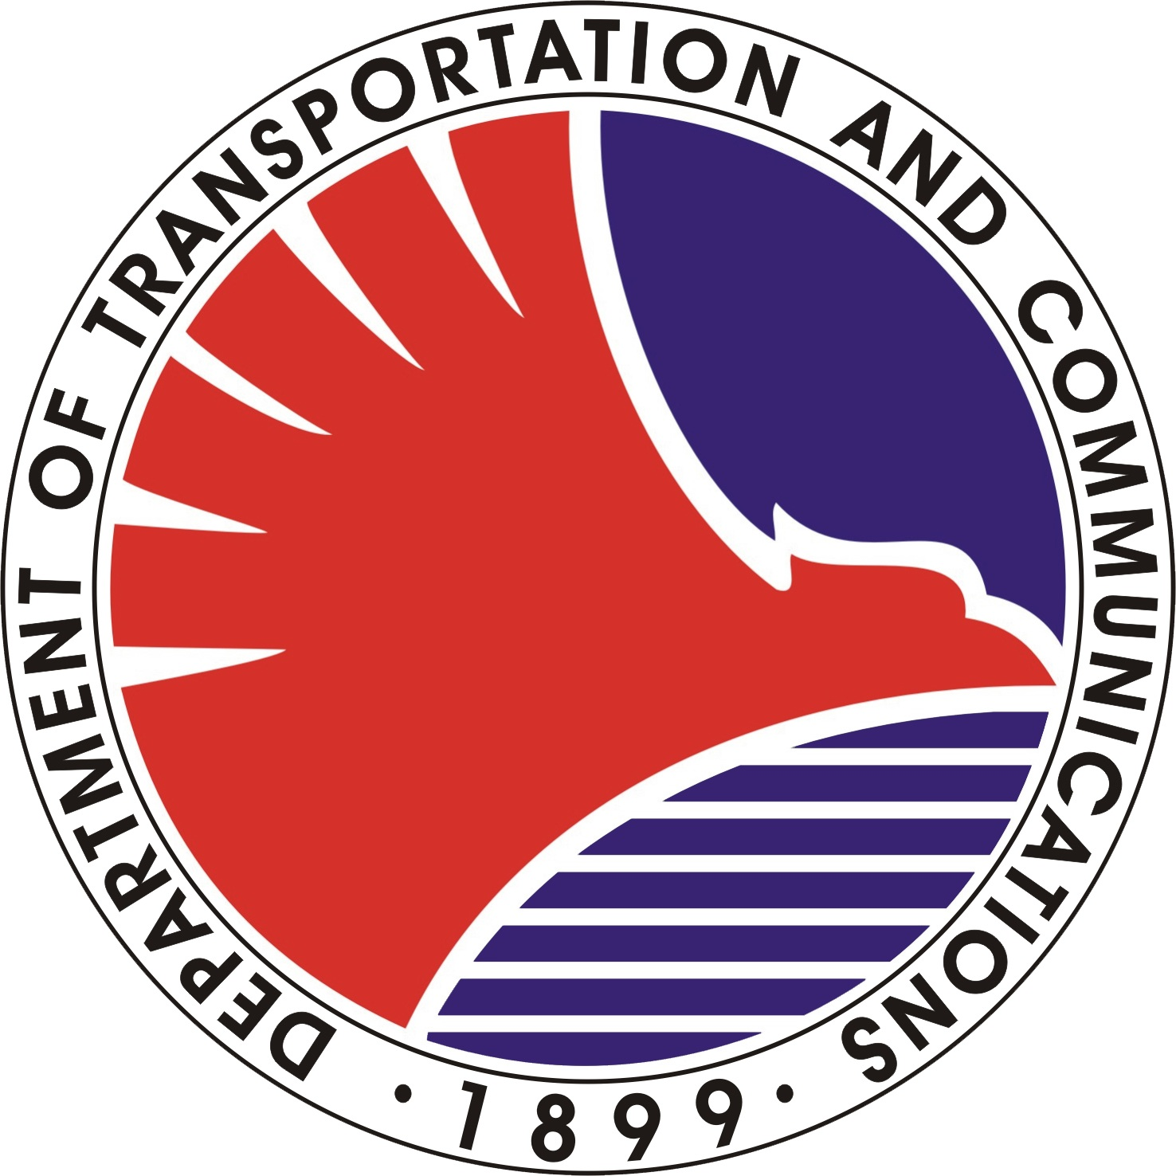
REPUBLIC OF THE PHILIPPINES
Department of Transportation and Communications Metro Rail Transit 3 (DOTC - MRT3)
This certificate is issued to
for having completed the training for Train Driver conducted by the Support Staff/Computer Section/AFC Center on June 24 - August 22, 2013 Given this 1st day of January 1970 at the North Triangle Area, Quezon City
JAMES PAUL CO

